Slide 1
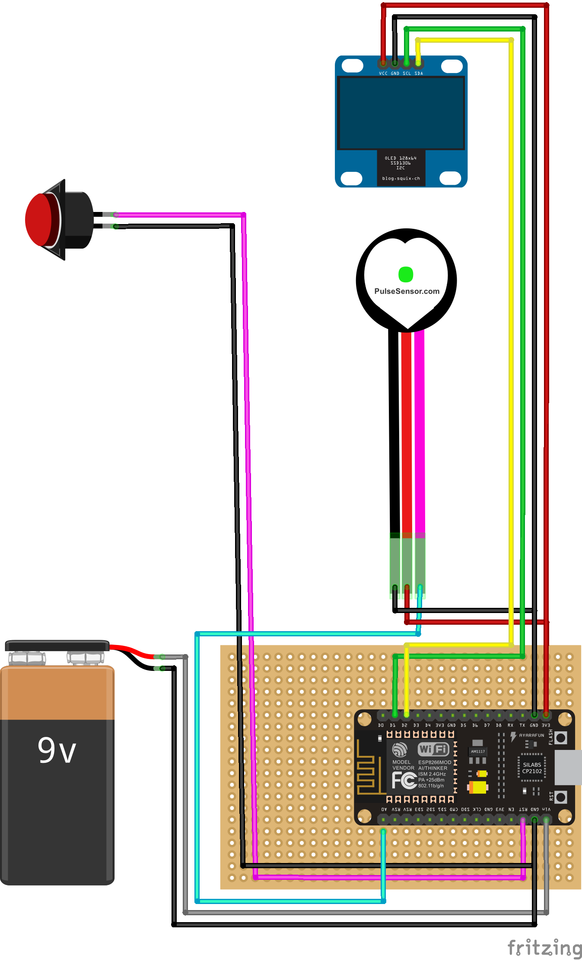
Wiring Diagram
List Component
1. ESP8266
2. Pulse Rate Sensor
3. OLED LCD 128x64 I2C
4. Reset Button
5. PCB/BreadBoard
6. Battery 9V
OLED LCD 128x64 I2C
Tombol Reset
Pulse Rate
Sensor
ESP8266 GPIO | OLED LCD 128x64 I2C | Reset Button | Pulse Rate Sensor | Battery 9V
VIN |  |  |  | +9V
3.3V | VCC |  | VCC
GND | GND | GND | GND | -9V
GPIO5 (D1) | SCL
GPIO4 (D2) | SDA
A0 |  |  | DATA
RST |  | RST
Catu Daya 9V
ESP8266

